Slide 1
Bayes’ theorem and independence

Slide 2
Recap
Probability space
Sample space S - set of outcomes
Events - subsets of sample space (technical condition)
Probability P - function from events to the closed interval [0,1]
Axioms
P(S) = 1
E₁, E₂, …. disjoint: P(E₁ ∪ E₂ ∪ … ) = P(E₁) + P(E₂) + …
Properties
P(Φ)=0, P(E^{c}) = 1 - P(E), P(E) = P(E ⋂ F) + P(E \ F), P(E ∪ F) = P(E) + P(F) - P(E ⋂ F)
Conditional probability - given event B has occurred
P(A | B) = P(A ⋂ B) / P(B) or P(A ⋂ B) = P(B) P(A | B)
Next set of lectures
More with conditional probability - Law of total probability and Bayes’ theorem
Independence and repeated trials of an experiment

Slide 3
Law of total probability

Slide 4
Law of total probability
P(A) = P(A ⋂ B) + P(A ⋂ B^{c}) = P(A | B) P(B) + P(A | B^{c}) P(B^{c})
S
Proof
A: disjoint union of A ⋂ B and A ⋂ B^{c}
By Axiom 2, P(A) = P(A ⋂ B) + P(A ⋂ B^{c})
Using conditional probability on each term above, we get the result
A
B
B^{c}

Slide 5
Example: Two urns with coloured marbles
Urn 1
Urn 2
Pick an urn at random and then pick a marble at random from the chosen urn.
P(red | urn 1) = 7/13, P(red | urn 2) = 5/13
P(blue | urn 1) = 6/13, P(blue | urn 2) = 8/13
P(red) = P(red | urn 1) P(urn 1) + P(red | urn 2) P(urn 2) = (7/13)(1/2) + (5/13)(1/2) = 6/13

Slide 6
Example: Economic model
An economic model predicts that if interest rates rise, then there is a 60% chance that unemployment will increase, but that if interest rates do not rise, then there is only a 30% chance that unemployment will increase. If the economist believes there is a 40% chance that interest rates will rise, what should she calculate is the probability that unemployment will increase?

Slide 7
More generally….
B₁, B₂, B₃, …. : Partition of S
P(A) = P(A ⋂ B₁) + P(A ⋂ B₂) + … = P(A | B₁) P(B₁) + P(A | B₂) P(B₂) + ...
S
Same proof as before
A
B₁
B₄
B₂
B₃

Slide 8
Example: Tricks with coins
A man possesses 5 coins - 2 are double-headed, 1 is double-tailed, 2 are normal. He picks a coin at random and tosses it. What is the probability that he sees a head?

Slide 9
Bayes’ theorem

Slide 10
Example: Two urns with coloured marbles
Urn 1
Urn 2
Pick an urn at random and then pick a marble at random from the chosen urn.
P(urn 1) = P(urn 2) = 1/2
P(red | urn 1) = 7/13, P(red | urn 2) = 5/13
P(blue | urn 1) = 6/13, P(blue | urn 2) = 8/13
What about P(urn 1 | red) or P(urn 1 | blue)?

Slide 11
Example: Flu test
1% of people in a city have Swine Flu.
Flu test: 95% of people with Swine Flu test positive 2% of people without the disease will test positive
A person is randomly chosen from the city and tests positive. What is the probability that the person actually has Swine Flu?
P(Swine Flu) = 0.01
P(positive | Swine Flu) = 0.95 and P(positive | Swine Flu^{c}) = 0.02
What is P(Swine Flu | positive)?

Slide 12
Problem
Two events: A and B
P(A) and P(B) are known.
P(A | B) and P(A | B^{c}) are either known or easy to find.
Question: Find P(B | A) and P(B^{c} | A).

Slide 13
Bayes’ theorem
A, B: events with P(A) > 0, P(B) > 0
P(A ⋂ B) = P(B) P(A | B) = P(A) P(B | A)
P(B | A) = P(B) P(A | B) / P(A)
S
A
A ⋂ B
B
Bayes’ theorem along with law of total probability can be used to solve the problems described in the previous slides.

Slide 14
Example: Two urns with coloured marbles
Urn 1
Urn 2
Pick an urn at random and then pick a marble at random from the chosen urn.
Event B: urn 1 is chosen, and Event A: red marble is picked
P(B) = 1/2, P(B^{c}) = 1/2
P(A | B) = 7/13, P(A | B^{c}) = 5/13. By law of total probability, P(A) = 6/13
P(urn 1 | red) = P(B | A) = P(B) P(A | B) / P(A) = (1/2)(7/13) / (6/13) = 7/12

Slide 15
Example: Flu test
1% of people in a city have Swine Flu.
Flu test: 95% of people with Swine Flu test positive 2% of people without the disease will test positive
A person is randomly chosen from the city and tests positive. What is the probability that the person actually has Swine Flu?
B: Person has Swine Flu, A: Person tests positive
P(B) = 0.01, P(B^{c}) = 0.99
P(A | B) = 0.95 and P(A | B^{c}) = 0.02 => P(A) = 0.95 x 0.01 + 0.02 x 0.99 = 0.0293
Bayes’ theorem: P(B | A) = 0.01 x 0.95 / 0.0293 = 0.3242… = 32.42% (surprise!)

Slide 16
Example: Multiple choice question (MCQ)
A student attempting an MCQ with 4 choices (of which one is correct) knows the correct answer with probability 3/4. If she does not know, she guesses a random choice. Given that a question was answered correctly, what is the conditional probability that she knew the answer?

Slide 17
Example: Roll a die and toss coins
You first roll a fair die, then toss as many fair coins as the number that showed on the die. Given that 5 heads are obtained, what is the probability that the die showed 5?

Slide 18
Independence

Slide 19
Independence of two events
DEFINITION (Independence) Two events A and B are independent if
P(A ⋂ B) = P(A) P(B)
Motivation
If P(B) > 0, P(A | B) = P(A)
Probability of A in original space is equal to the conditional probability of A given B in the conditional space
Probability of A is unaffected by occurrence of B, i.e. A and B are independent
Rules for multiplication and addition
When Event 1 and Event 2 are independent, P(Event 1 and Event 2) = P(Event 1) P(Event 2)
Multiply probabilities to find the probability of “and” of independent events
Contrast with disjoint or mutually exclusive events A and B: P(A ∪ B) = P(A) + P(B)
Add probabilities to find probability of “or” of disjoint events

Slide 20
Example: Toss a coin thrice
Uniform{ HHH, HHT, HTH, HTT, THH, THT, TTH, TTT }
A: First toss is heads, B: Second toss is heads
A = { HHH, HHT, HTH, HTT }, B = { HHH, HHT, THH, THT }
A ⋂ B = { HHH, HHT }
P(A ⋂ B) = 1/4 = 1/2 x 1/2 = P(A) P(B)
A and B are independent
What about A and B^{c}? What about 1st toss if heads and 3rd toss is heads?

Slide 21
Example: Throw a die
A: even, B: odd
A = { 2, 4, 6}, B = { 1, 3, 5 }
A ⋂ B = Φ
P(A ⋂ B) = 0 ≠ P(A) P(B)
Point to remember:
Disjoint events are never independent
Why? If A and B are disjoint and B occurs, A definitely did not occur
Occurrence of B definitely impacts conditional probability of A!
For events to be independent, they should have a non-empty intersection

Slide 22
Example: Throw a die
A: even number, B: multiple of 3
A = { 2, 4, 6}, B = { 3, 6 }
A ⋂ B = { 6 }
P(A ⋂ B) = 1/6 = 1/2 x 1/3 = P(A) P(B)
A and B are independent
Typical points of confusion:
A and B have an intersection. How can they be independent?
There is only one throw of the die. How can two events be independent when there is only one throw?

Slide 23
Example: Card from a pack
A: Card is an spade, B: Card is a king
A ⋂ B: Card is spade-king
P(A ⋂ B) = 1/52 = 1/4 x 1/13 = P(A) P(B)
A and B are independent
Typical points of confusion:
Isn’t there a spade-king card? How can card being a spade be independent of card being a king when there is a spade king card?
There is only one card drawn. How can two events be defined and be independent when there is only one card?

Slide 24
Mutual independence of three events
DEFINITION (Mutual Independence) Events A, B, C are mutually independent if
P(A ⋂ B) = P(A) P(B), P(A ⋂ C) = P(A) P(C), P(B ⋂ C) = P(B) P(C)
P(A ⋂ B ⋂ C) = P(A) P(B) P(C)
Two constraints
A and B are independent, A and C are independent, B and C are independent
Additional constraint on A ⋂ B ⋂ C - this is important
Example: Toss a coin twice
A = { HH, TT }, B = { HH, HT }, C = { HH, TH }
A and B, A and C, B and C: independent pairwise
However, P(A ⋂ B ⋂ C) = 1/4 ≠ P(A) P(B) P(C)
Pairwise independent but not mutually independent

Slide 25
Mutual independence of multiple events
DEFINITION (Mutual Independence) Events A₁, A₂,..., A_{n} are mutually independent if, for all i1, i2, …, ik,
P(A_{i1} ⋂ A_{i2} ⋂ … ⋂ A_{ik}) = P(A_{i1}) P(A_{i2}) … P(A_{ik})
Almost 2^{n} constraints
Prob{Intersection of any subset of events} = Product of the Prob{events}
Interesting result: A and B are independent => A and B^{c} are independent
P(A ⋂ B^{c}) = P(A \ B) = P(A) - P(A ⋂ B) = P(A)(1 - P(B)) = P(A) P(B^{c})
Intuitive: B does not affect A => B^{c} does not affect A
Two events are independent => Complement of one event and other event are independent
Using the above twice: A and B are independent => A^{c} and B^{c} are independent
Extension: n events are mutually independent => any subset with or without complementing are independent as well

Slide 26
Example: Roads
Two roads each connect A and B and B and C. Each of the four roads gets blocked with probability p independent of all other roads. What is the probability that there is an open route from A to B given that there is no open route from A to C?
A
B
C

Slide 27
Repeated independent trials - Bernoulli, Binomial and Geometric Distribution

Slide 28
Bernoulli trials

Slide 29
Example: Incidence of a disease
Suppose you want to find out how many people in a city suffer from a disease.
Trial: Select a random person from a population and test for a disease.
Repeat trial n times. Assume each trial is independent.
Observation: number of times the test was positive
Questions: What is the distribution of the above number?
More interesting question: What fraction of people have the disease?

Slide 30
A single Bernoulli trial
Setting: Occurrence of Event A in a sample space is considered “success”. Non-occurrence of A is considered “failure”. Let p = P(A).
Bernoulli trial: Sample space is {success, failure} with P(success) = p or {0, 1} with P(1) = p, P(0) = 1 - p
This distribution is denoted Bernoulli(p).
In previous example, a Bernoulli trial is a framework for one test.

Slide 31
Repeated Bernoulli trials
Setting: Repeat a Bernoulli trial multiple times independently.
Perform n independent Bernoulli(p) trials.
Outcome: 0 or 1 (Trial 1), 0 or 1 (Trial 2), 0 or 1 (Trial 3), … … , 0 or 1 (Trial n)
Sample space: 2^{n} outcomes Eg: n = 3, S = { 000, 001, 010, 011, 100, 101, 110, 111 } n = 4, S = { 0000, 0001, 0010, 0011, 0100, 0101, 0110, 0111, 1000, 1001, 1010, 1011, 1100, 1101, 1110, 1111 }
Probabilities: Use independence. Let n = 3. P(000) = P(trial 1 is 0 and trial 2 is 0 and trial 3 is 0) = (1-p) x (1-p) x (1-p) = (1-p)³ P(101) = P(trial 1 is 1 and trial 2 is 0 and trial 3 is 1) = p x (1-p) x p = p²(1-p)

Slide 32
Example: Toss a fair coin 5 times
Toss a fair coin 5 times. H is 0 and T is 1. Sample space has 32 equally likely outcomes.
For example, P(HHHHH) = 1/32, P(HTHTH) = 1/32, P(THTHT) = 1/32 etc.
P(0 tails) = P(HHHHH) = 1/32
P(1 tail) = P({THHHH, HTHHH, HHTHH, HHHTH, HHHHT}) = 5/32
P(2 tails) = P({TTHHH, THTHH, THHTH, THHHT, HTTHH, HTHTH,HTHHT, HHTTH, HHTHT, HHHTT}) = 10/32
P(3 tails) = P({TTTHH, TTHTH, TTHHT, THTTH, THTHT, THHTT, HTTTH, HTTHT, HTHTT, HHTTT}) = 10/32
P(4 tails) = P({TTTTH, TTTHT, TTHTT, THTTT, HTTTT}) = 5/32
P(5 tails) = P(TTTTT) = 1/32

Slide 33
Example: Toss a coin 5 times (using uniform distribution)
Toss a fair coin 5 times. H is 0 and T is 1. Sample space has 32 outcomes.
P(0 tails) = 5C₀ favourable out of 32 = 1/32 = P(5 heads) P(1 tail) = 5C₁ favourable out of 32 = 5/32 = P(4 heads) P(2 tails) = 5C₂ favourable out of 32 = 10/32 = P(3 heads) P(3 tails) = 5C₃ favourable out of 32 = 10/32 = P(2 heads) P(4 tails) = 5C₄ favourable out of 32 = 5/32 = P(1 head) P(5 tails) = 5C₅ favourable out of 32 = 1/32 = P(0 heads)
P(at least 4 tails) = P(4 tails or 5 tails) = 5/32 + 1/32 = 6/32 P(at most 3 heads) = P(0 or 1 or 2 or 3 heads) = 1/32+5/32+10/32+10/32 = 26/32

Slide 34
Computing probabilities for Bernoulli trials
Perform n independent Bernoulli(p) trials.
Ex: n = 10 P(0110001011) = (1-p) x p x p x (1-p) x (1-p) x (1-p) x p x (1-p) x p x p = p⁵ (1-p)⁵
In general,
P(b₁b₂….b_{n}) = p^{w} (1-p)^{n - w}, where w = no of 1s in b₁b₂….b_{n}
The actual sequence of 0s and 1s does not matter. Only the number of successes matters in the probability computation.
Ex: P(b₁b₂….b₂₀₀ with 36 1s) = p³⁶ (1 - p)²⁰⁰ ⁻ ³⁶ = p³⁶ (1 - p)¹⁶⁴

Slide 35
Example: Toss a biased coin 5 times
H is 0 and T is 1. P(H) = 1/3, P(T) = 2/3.
P(HHHHH) = (1/3)⁵, P(TTTTT) = (2/3)⁵
P(1 tail) = P({THHHH, HTHHH, HHTHH, HHHTH, HHHHT}) = 5(2/3)(1/3)⁴
P(2 tails) = P({TTHHH, THTHH, THHTH, THHHT, HTTHH, HTHTH,HTHHT, HHTTH, HHTHT, HHHTT}) = 5(2/3)²(1/3)³
P(3 tails) = P({TTTHH, TTHTH, TTHHT, THTTH, THTHT, THHTT, HTTTH, HTTHT, HTHTT, HHTTT}) = 5(2/3)³(1/3)²
P(4 tails) = P({TTTTH, TTTHT, TTHTT, THTTT, HTTTT}) = 5(2/3)⁴(1/3)

Slide 36
Revisit Example: Incidence of a disease
Suppose a fraction of the people in a city have a disease.
Trial: Select a random person from a population and test for a disease.
We will assume that the probability that a person tests positive is ‘p’.
Can ‘p’ be assumed to be the fraction having the disease? When is this a good assumption?
Repeat trial n times. Assume each trial is independent.
Observation: number of times the test was positive
Questions: What is the distribution of the above number in terms of n and p?

Slide 37
Binomial distribution

Slide 38
Binomial(n, p): Binomial distribution
Perform n independent Bernoulli(p) trials.
Outcome: number of successes, which we will denote B(n,p) or B in short
Sample space: { 0, 1, 2, …, n }
Ex: n = 3
P(B = 0) = P(trials result in 000) = (1 - p)³
P(B = 1) = P(trials result in 001 or 010 or 100) = p(1 - p)²+p(1 - p)²+p(1 - p)² = 3p(1-p)²
P(B = 2) = P(trials result in 011 or 101 or 110) = p²(1 - p)+p²(1 - p)+p²(1 - p) = 3p²(1-p)
P(B = 3) = P(trials result in 011) = p³

Slide 39
Binomial(5, p)
n = 5. B = no of successes in n Bernoulli(p) trials
P(B = 0) = P(trials result in 00000) = (1 - p)⁵
P(B = 1) = P(trials result in 00001 or 00010 or 00100 or 01000 or 10000) = p(1 - p)⁴ + p(1 - p)⁴ + p(1 - p)⁴ + p(1 - p)⁴ + p(1 - p)⁴ = 5p(1-p)²
P(B = 2) = P(trials result in 00011 or 00101 or 01001 or 10001 or 00110 01010 or 10010 or 01100 or 10100 or 11000) = p²(1 - p)³ + p²(1 - p)³ + p²(1 - p)³ + p²(1 - p)³ + p²(1 - p)³ + p²(1 - p)³ +p²(1 - p)³ + p²(1 - p)³ + p²(1 - p)³ + p²(1 - p)³ = 10p²(1-p)³
P(B = 3) = P(trials result in 3 1s)=(no of favourable outcomes)p³(1-p)²=5C₃p³(1-p)²=10p³(1-p)²
P(B = 4) = P(trials result in 4 1s)=(no of favourable outcomes)p⁴(1-p) = 5C₄p⁴(1-p) = 5p⁴(1-p)
P(B = 5) = P(trials result in 5 1s) = p⁵

Slide 40
Binomial(n,p): small n
Probability of number of successes
 | B = 0 | B = 1 | B = 2 | B = 3 | B = 4 | B = 5 | B = 6
n = 1 | 1 - p | p
n = 2 | (1 - p)² | 2p(1 - p) | p²
n = 3 | (1 - p)³ | 3p(1 - p)² | 3p²(1 - p) | p³
n = 4 | (1 - p)⁴ | 4p(1 - p)³ | 6p²(1 - p)² | 4p³(1 - p) | p⁴
n = 5 | (1 - p)⁵ | 5p(1 - p)⁴ | 10p²(1 - p)³ | 10p³(1 - p)² | 5p⁴(1 - p) | p⁵
n = 6 | (1 - p)⁶ | 6p(1 - p)⁵ | 15p²(1 - p)⁴ | 20p³(1 - p)³ | 15p⁴(1 - p)² | 6p⁵(1 - p) | p⁶

Slide 41
Binomial(n, p): Expression for probability
In general, what is P(B(n,p) = k)? (k = 0, 1, 2, …, n)
P(B(n,p) = k) = P(trial results in b₁b₂….b_{n} with exactly k 1s)
= (no of b₁b₂….b_{n} with exactly k 1s) p^{k} (1 - p)^{n - k}
No of b₁b₂….b_{n} with exactly k 1s = n C _{k} = n! / (k! (n-k)!)
P(B(n,p) = k) = n C _{k} p^{k} (1 - p)^{n - k}

Slide 42
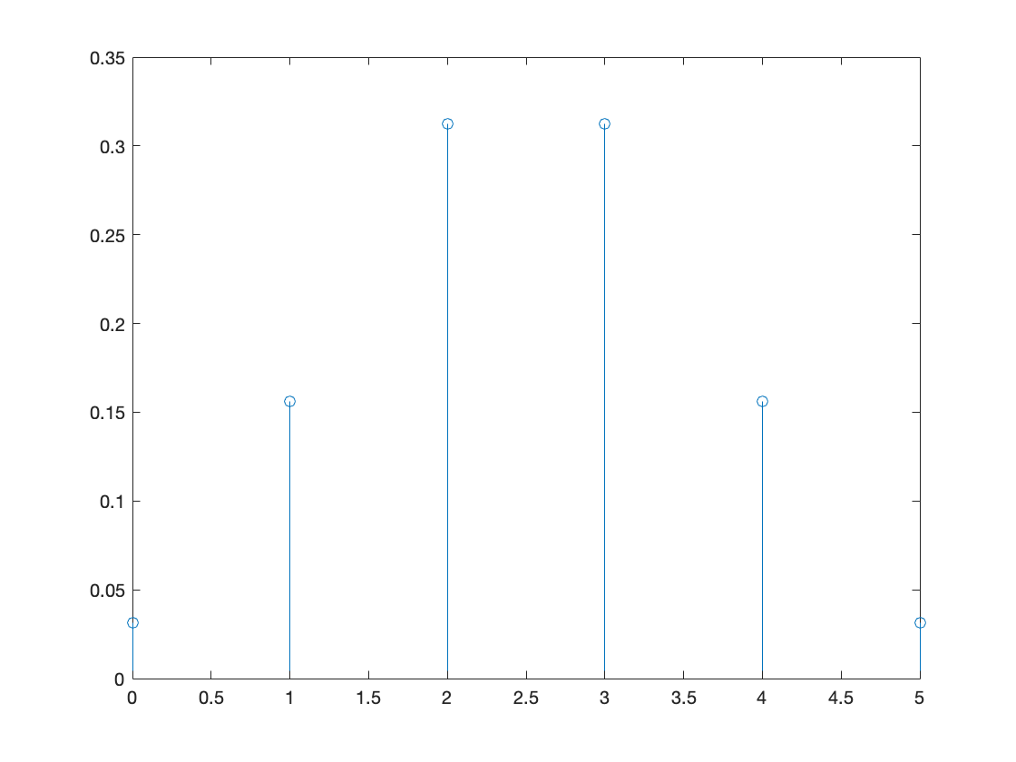
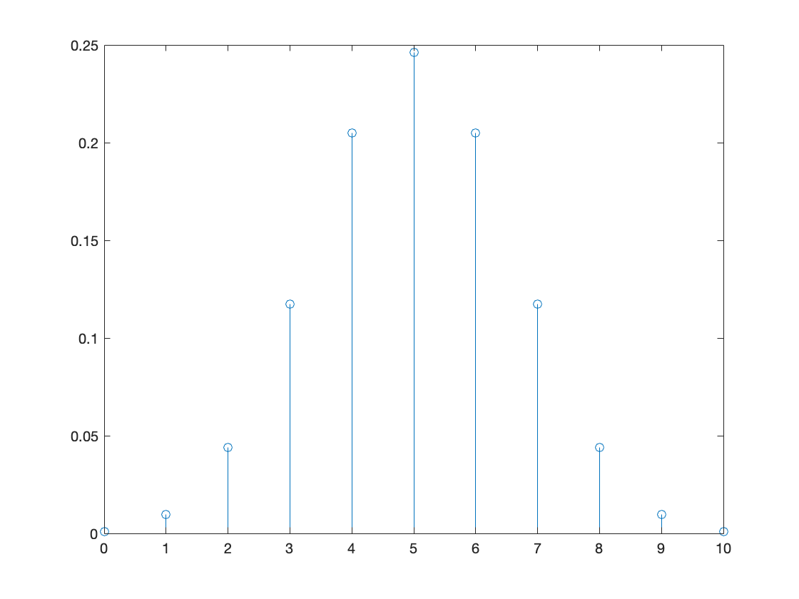
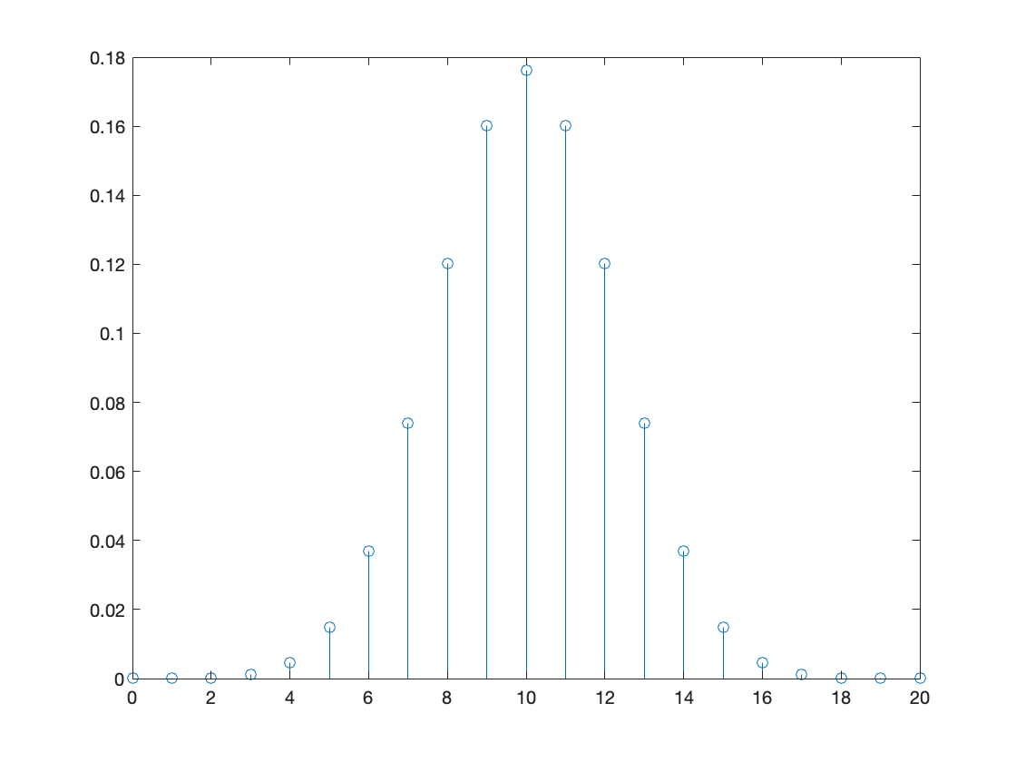
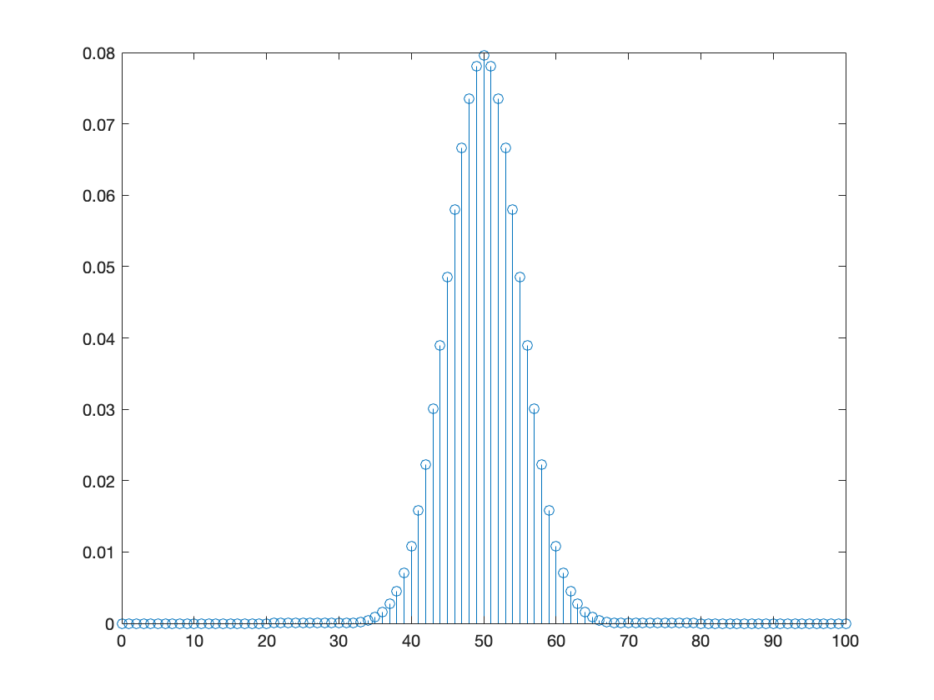
Binomial(n, 0.5)
n = 5
n = 10
n = 20
n = 100

Slide 43
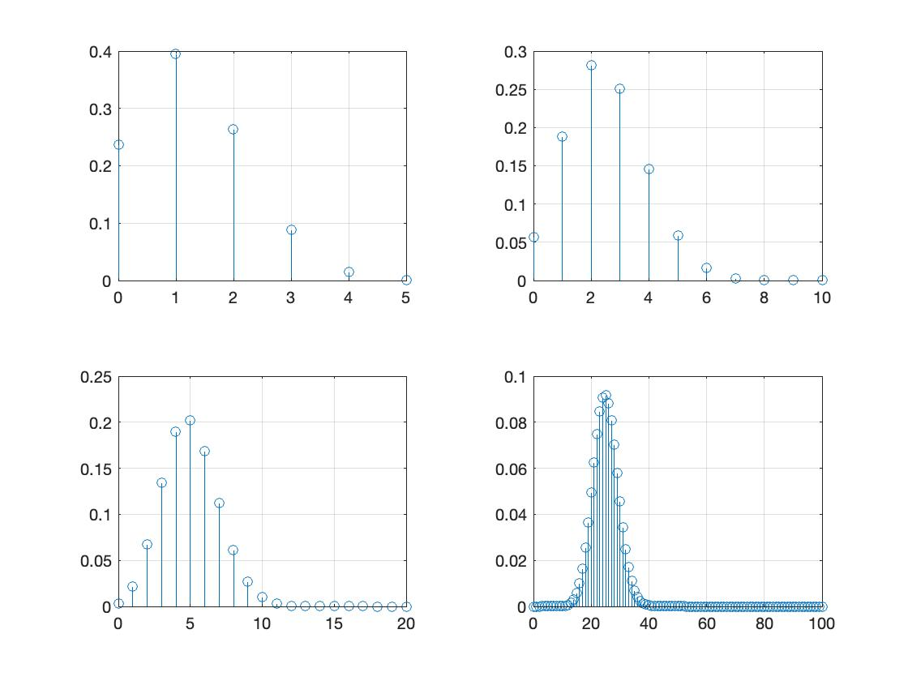
p = 0.25, n = 5, 10, 20, 100

Slide 44
Some observations
Starts at (1-p)^{n} -> increases and reaches a peak -> falls to p^{n}
Where is the peak? Near np
Exactly, floor(p(n+1)), i.e. largest integer <= p(n+1)
P(B = 0 or B = 1 or B = 2 or …. or B = n) = 1
P(B = 0) + P(B = 1) + P(B = 2) + …. + P(B = n) = 1
(1-p)^{n} + nC₁ p(1-p)^{n-1} + nC₂ p²(1-p)^{n-2} + … + p^{n} = 1 (important identity)
Check the above identity for n = 1, 2, 3, 4….

Slide 45
Example: Incidence of a disease
Each person has a disease with probability 0.1 independently. Out of 100 random persons tested for the disease, what is the probability that 20 persons test positive? Assume that the disease can be tested accurately with no false positives.

Slide 46
Think about this one: Such questions will come later!
Each person has a disease with probability p independently. Out of 100 random persons tested for the disease, suppose that 20 persons test positive. What is p? Assume that the disease can be tested accurately with no false positives.

Slide 47
Example: Coin toss
Suppose a fair coin is tossed 10 times. (a) What is the probability that the number of heads is a multiple of 3? (b) What is the probability that the number of heads is even?

Slide 48
Example: Communicating bits
A bit (0 or 1) sent by Alice to Bob gets flipped with probability 0.1. (a) If 5 bits are sent by Alice independently, what is the probability that at most 2 bits get flipped? (b) If 10 bits are sent by Alice independently, what is the probability that at most 2 bits get flipped?

Slide 49
Geometric distribution

Slide 50
Example: Tossing coins till you get a head
Suppose you toss a fair coin repeatedly (independently) till you get a head. How many times will you toss the coin?
P(1) = P(heads in first toss) = 1/2
P(2) = P(tails in first toss and heads in second toss) = 1/2 x 1/2 = 1/4
P(3) = P(1T and 2T and 3H) = 1/2 x 1/2 x 1/2 = 1/8
…..
P(k) = P(1T and 2T and …. and (k-1)T and kH) = (1/2)^{k}
….

Slide 51
Example: Throw a die till you get 1
In Ludo, a player needs to repeatedly throw a die till she gets a 1. How many throws are needed?
P(1) = 1/6
P(2) = P(not 1 in first throw and 1 in second throw) = 5/6 x 1/6 = 5/36
P(3) = P(not 1 and not 1 and 1) = 5/6 x 5/6 x 1/6 = 25/216
….
P(k) = (5/6)^{k - 1} (1/6) = 5^{k - 1}/6^{k}
….

Slide 52
Geometric(p): Geometric distribution
Perform independent Bernoulli(p) trials indefinitely.
Outcome: Number of trials needed for first success, which we denote G(p) or G
Sample space: { 1, 2, 3, 4, 5, 6, …. (goes on and on)}
P(G = 1) = P(first trial is success) = p
P(G = 2) = P(first trial is failure and second trial is failure) = (1-p) p
P(G = 3) = P(trial result: 001) = (1-p)²p
….
P(G = k) = P(first k-1 trials result in 0 and k-th trial is 1) = (1-p)^{k-1} p
….

Slide 53
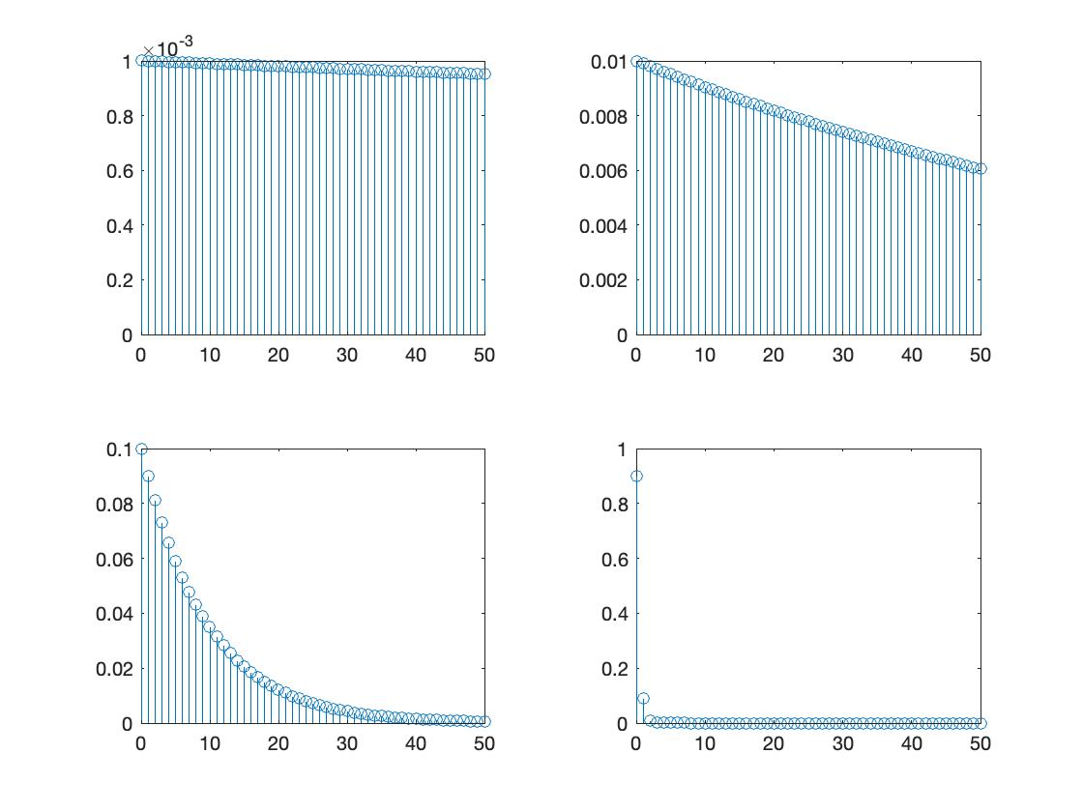
Plot of geometric distribution (shown till k = 50)
p = 0.001
p = 0.01
p = 0.1
p = 0.99

Slide 54
Some observations
Starts at p and keeps falling
Keeps on decreasing but, if p<1, never goes all the way to zero
P(G ≤ k) = P(G = 1 or G = 2 or ….. or G = k)
P(G ≤ k) = P(G = 1) + P(G = 2) + …. + P(G = k)
P(G ≤ k) = p + (1 - p)p + (1 - p)²p + …. + (1 - p)^{k-1}p = 1 - (1 - p)^{k} (important identity)

Slide 55
Example: Throw a die till you get 1
In Ludo, a player needs to repeatedly throw a die till she gets a 1. What is the probability that she needs lesser than 6 throws? What is the probability that she needs lesser than 11 throws? What is the probability that she needs lesser than 21 throws?
P(lesser than 6 throws) = P(G = 1 or …. or G = 5) = 1/6 + 5/6 x 1/6 + (5/6)²(1/6) + (5/6)³(1/6) + (5/6)⁴(1/6) = 1 - (5/6)⁵ = 0.5981
P(lesser than 11 throws) = 1/6 + 5/6 x 1/6 + (5/6)²(1/6) + …. + (5/6)¹⁰(1/6) = 1 - (5/6)¹¹ = 0.8654
P(lesser than 21 throws) = 1/6 + 5/6 x 1/6 + (5/6)²(1/6) + …. + (5/6)²⁰(1/6) = 1 - (5/6)²¹ = 0.9783

Slide 56
Example: Basketball free throw contest
Player 1 is a 40% free throw shooter, while Player 2 is a 70% shooter. Each throw is independent of all previous throws. The two players alternate shooting with Player 1 starting till the first basket is scored.
What is the probability that Player 1 wins before the 3rd round?
What is the probability that Player 1 wins?

